Slide 1
AI vs. Human: Academic Essay Authenticity Challenge
PIP2001 Capstone Project
Review-0
Batch Number: CST-G09
Roll Number | Student Name
20211CST0067 | WARALE AVINASH KALYAN
20211CST0059 | SIDDHARTH PAGARIA
20211CST0076 | CHAITRA V
20211CST0085 | SPOORTHI HG
Under the Supervision of,
Dr. Sandeep Albert
Assistant Professor
School of Computer Science and Engineering
Presidency University
Name of the Program: B.Tech Computer Science Technology (AI & ML)
Name of the HoD: Dr. Saira Banu
Name of the Program Project Coordinator: Dr. H M Manjula (AP)
Name of the School Project Coordinators: Dr. Abdul Khadar A

Slide 2
Content
Problem Statement
Github Link
Analysis of Problem Statement
Timeline of the Project
References

Slide 3
Problem Statement Number: PSCS180
Organization: Presidency University
Category : Software
Problem Description: The objective is to identify machine-generated essays to safeguard academic integrity and prevent the misuse of large language models in educational settings. The input to the system would be essays including texts authored by both native and non-native speakers, as well as essays generated by various large language models. The task is defined as follows: "Given an essay, identify whether it is generated by a machine or authored by a human." This is a binary classification task and is offered in English.
Difficulty Level: Complex/Medium

Slide 4
Github Link
The Github link provided should have public access permission.
Github Link :- Github Repo

Slide 5
Analysis of Problem Statement
Technology Stack Components:
Data Collection & Preprocessing: Diverse text corpus, annotation tools.
Data Storage: Databases, cloud storage.
NLP: Preprocessing libraries, language models.
Machine Learning: Training frameworks, pre-trained models.
Model Training & Evaluation: Computing resources, evaluation metrics.
Feature Engineering: Extraction tools.
Deployment: Model serving, scalable deployment.
User Interface: Web application, admin dashboard.
Security & Privacy: Encryption, access control.
Monitoring & Maintenance: Logging, model updating.

Slide 6
Analysis of Problem Statement (contd...)
Software Requirements:
Python
TensorFlow/PyTorch/Hugging Face
NLP libraries (NLTK/SpaCy)
SQL/NoSQL databases
Web frameworks .

Slide 7
Analysis of Problem Statement (contd...)
To build a system that effectively distinguishes between machine-generated and human-authored essays, we need a comprehensive technology stack. Data Collection and Preprocessing involves acquiring a diverse set of essays in English, and manually annotating them to label each text accurately. For Data Storage, we'll use relational databases like PostgreSQL or MySQL, explore NoSQL options such as MongoDB, and leverage scalable cloud storage solutions like AWS S3.
In the Natural Language Processing (NLP) phase, we'll employ text preprocessing libraries such as NLTK and SpaCy, and utilize pre-trained language models like BERT, GPT, and AraBERT for feature extraction and classification. Machine Learning Frameworks like TensorFlow and PyTorch will be essential for developing and fine-tuning our models.
For Model Training and Evaluation, we'll require high-performance computing resources, potentially sourced from cloud services. We'll assess model performance using metrics such as accuracy and F1 score to ensure effectiveness.
The User Interface will include a web application built with React for the front end and Django for the back end, along with an Admin Dashboard to manage and oversee the system efficiently.

Slide 8
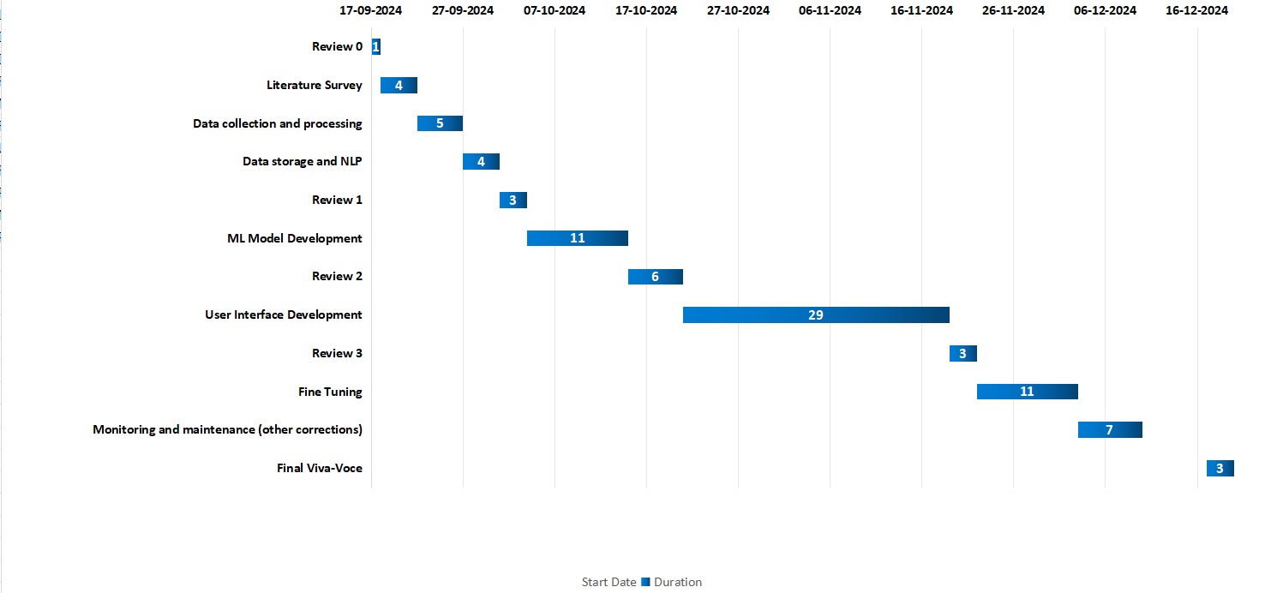
Timeline of the Project (Gantt Chart)

Slide 9
References (IEEE Paper format)
Cingillioglu, I. (2023). Detecting AI-generated essays: The ChatGPT challenge. The International Journal of Information and Learning Technology. https://doi.org/10.1108/IJILT-03-2023-0043
Walters, W. H. (2023). The effectiveness of software designed to detect AI-generated writing: A comparison of 16 AI text detectors. Open Information Science. https://doi.org/10.1515/opis-2022-0158
Liu, Y., Zhang, Z., Zhang, W., Yue, S., Zhao, X., Cheng, X., Zhang, Y., & Hu, H. (2023). ArguGPT: Evaluating, understanding, and identifying argumentative essays generated by GPT models. ArXiv. https://arxiv.org/abs/2304.07666
Dergaa, I., Chamari, K., Żmijewski, P., & Ben Saad, H. (2023). From human writing to artificial intelligence generated text: Examining the prospects and potential threats of ChatGPT in academic writing. Biology of Sport. https://www.ncbi.nlm.nih.gov/pmc/articles/PMC10108763/
Corizzo, R., & Leal-Arenas, S. (2023). One-class learning for AI-generated essay detection. Applied Sciences, 13(13), 7901. https://www.mdpi.com/2076-3417/13/13/7901

Slide 10


